Slide 1
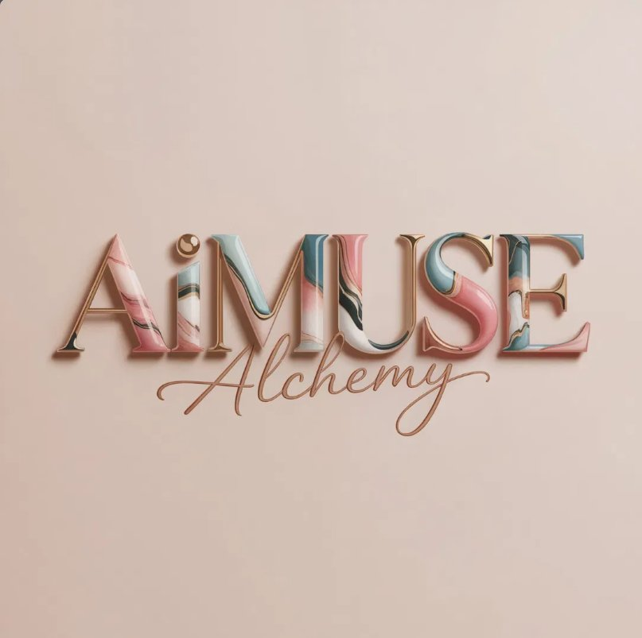
BOSS ERA™ × AIMUSE ALCHEMY™
Free Guide:
How to Start
Building an
AI Influencer
The feminine framework for AI-powered
authority, content, and digital income.
1.6K+
2K+
4+
bossfacelessmentor.com
Muses
AI Prompts
Muse Bots

Slide 2
INTRODUCTION
What Is an AI Influencer — and Why It Matters Now
In 2026, having an AI avatar isn't special. Everyone has one. What separates the creators building real digital businesses from those just generating pretty pictures is one thing: a living brand identity built around a Muse.
Why This Is a Major Opportunity Right Now
Faceless content is one of the fastest-growing formats on Instagram and TikTok
The creators who build systems now will own the category in 12 months
AI-generated personas are reaching millions — with zero on-camera presence
You do not need followers to start — you need a framework
Digital products, UGC, affiliate income, and brand deals all work with AI content
This guide gives you the exact starter framework.
Boss Era™ × AiMUSE Alchemy™ · bossfacelessmentor.com

Slide 3
01
THE FRAMEWORK
The AI Influencer Starter Framework
Six steps from zero to a working AI content system

Slide 4
THE AI INFLUENCER STARTER FRAMEWORK
01
02
03
Define Your Muse & Avatar
Choose a Niche & Visual Identity
Create Consistent Prompts
Your Muse is a character — a visual persona with a consistent aesthetic, personality, and world. She is not you. She is the version of the brand your audience falls in love with.
The riches are in the niches. A Muse that tries to be everything is remembered as nothing. Pick one lane and own it completely.
Your prompt is your paintbrush. The more specific and consistent your prompting language, the more recognizable your Muse becomes.
→ Give your Muse a name, a vibe, and a visual world
→ Luxury lifestyle & aspirational content
→ Always include: lighting, setting, mood, outfit, camera angle
→ Define her aesthetic: luxury, editorial, soft life, dark feminine, coastal
→ UGC beauty, skincare, and wellness
→ Build a 'Muse Prompt Signature' — a reusable block for every image
→ Choose 3 adjectives describing every image she appears in
→ AI fashion and editorial imagery
→ Test variations until you find her — then lock it in
→ Consistency is everything — she must look the same across every post
→ Business, digital income, and empowerment
→ Use negative prompts to remove what you don't want
Boss Era™ × AiMUSE Alchemy™ · bossfacelessmentor.com

Slide 5
THE AI INFLUENCER STARTER FRAMEWORK
04
05
06
Generate Consistent Luxury Content
Build a Posting & Content System
Monetize Your Muse
Once your Muse is defined, content becomes a system — not a creative challenge.
Consistency beats quality. A Muse that posts every day with good content will outperform one that posts perfectly once a week.
Your Muse is not just an aesthetic — she is an income asset. Here is how AI influencers generate real revenue:
→ Batch generate 30 images in one session
→ Post 5–7x per week minimum
→ Digital products — guides, templates, systems, courses
→ Create carousel posts, Reel covers, Story content & product mockups
→ Rotate: aspirational → educational → soft sell → identity
→ Affiliate marketing — promote tools and programs you believe in
→ Use AI video tools to bring static Muses to life
→ Use DM keywords to trigger automated conversations
→ UGC content creation — brands pay for AI-generated product content
→ Keep a brand board of approved images as your visual reference
→ Batch content weekly — one 2-hour session per week is enough
→ Community & membership — exclusive access to your Muse's world
Results shown are examples, not guarantees. Independent income depends on your expertise, effort and execution.

Slide 6
02
THE SYSTEM
AiMUSE Alchemy™
The complete AI creation & branding system for digital creators

Slide 7
AiMUSE ALCHEMY™ · INSIDE THE SYSTEM
1,600+
2,000+
4+
9
Muses Inside
AI Prompts
Director Bots
Creation Modules
The 4 AI Director Bots
The 9 Creation Modules
AiMUSE Video Director Bot
Create Your Muse — Build your AI persona from scratch
Directs AI video creation from concept to final output — storylines, scene directions, and video prompts.
Storytelling Mastery & Brand DNA — Your identity system
AiMUSE Prompt Director Bot
AI Fashion Hauls & Try-Ons — Without a wardrobe
Your personal prompt architect. Feed it your Muse's aesthetic and it builds custom image prompts.
Visual Hooks to Stop the Scroll — Every platform
AI Video Podcasting — From script to screen with AI
Soul 2.0 Luxury Influencer Architect
UGC & Branded Product Visuals — High-converting content
Specializes in high-end editorial luxury content for fashion, beauty and aspirational lifestyle.
Viral Trends & Dance Workflows — Trend-based systems
AiMUSE Seedance 2.0 Studio
AI Music — Original audio branding for your content
The motion specialist — turns your Muse into moving content with structured animation prompts.
CapCut Editing Tutorials — Polish AI content into pieces
Boss Era™ × AiMUSE Alchemy™ · bossfacelessmentor.com

Slide 8
CLAUDE AI × HIGGSFIELD MCP · WORKFLOW GUIDE
Using Claude + Higgsfield MCP for AI Content Workflows
Claude = Creative Director
Higgsfield = Video Engine
Guided Pipeline
Describe what you want — it structures the full workflow for you.
Handles motion, animation, and cinematic sequences at scale.
Concept → video prompt → final output. Dramatically speeds up creation.
Example Workflow: Muse Video Content
01 Brief Claude
04 Iterate
Describe your Muse: aesthetic, setting, lighting, mood, and what action you want in the video.
Review the output. Describe changes to Claude — it refines the prompt. Repeat until perfect.
02 Claude Structures the Prompt
05 Edit & Post
Claude builds a Higgsfield-ready prompt — camera direction, lighting specs, motion parameters.
Take into CapCut. Add music, text overlays, brand elements. Export and post.
03 Paste into Higgsfield
Take the structured prompt and paste into Higgsfield's interface. It generates the video.
Note: This workflow requires MCP to be set up in your Claude environment. Beginners should start with direct Claude prompting before connecting via MCP.

Slide 9
04
SAMPLE PROMPTS
Muse Prompt Examples
From the Vault
A small preview — the full vault has 2,000+ prompts inside AiMUSE Alchemy™

Slide 10
MUSE PROMPT EXAMPLES · SAMPLE PREVIEW ONLY
LUXURY LIFESTYLE · EDITORIAL
UGC BEAUTY · SKINCARE
A hyper-realistic AI influencer woman at a floor-to-ceiling window in a Paris penthouse suite, golden hour light, white silk robe, calm expression, cinematic depth of field, fashion editorial style, muted luxury palette.
Close-up of an AI influencer holding a glass serum bottle near her face, soft studio lighting, dewy skin texture, warm beige blurred background, natural makeup, lifestyle skincare aesthetic, clean and premium.
AI FASHION · EDITORIAL
CAR SELFIE · ASPIRATIONAL
Full-length shot of a dark-feminine AI influencer in a black structured blazer and wide-leg trousers, minimalist concrete architecture, dramatic side lighting, high fashion editorial mood, luxury brand aesthetic.
AI influencer woman in a black Rolls Royce Ghost, window down, golden sunset, oversized sunglasses and gold jewelry, candid lifestyle moment, warm cinematic color grade, aspirational soft life aesthetic.
CAROUSEL · EMPOWERMENT
DARK FEMININE · POWER
Minimalist typographic Instagram carousel slide, blush cream background, elegant serif font in deep plum, single authority quote centered, thin gold border frame, Boss Era aesthetic, clean and premium, white space dominant.
AI influencer woman at a marble desk with a glass of champagne, luxury items — Chanel bag, gold jewelry, laptop, dramatic low-key lighting, rich dark tones, powerful and mysterious energy, cinematic noir aesthetic.
These 6 prompts are examples only. AiMUSE Alchemy™ contains 2,000+ categorized prompts across every content category.

Slide 11
YOU HAVE THE FRAMEWORK.
Now get the complete system.
AiMUSE Alchemy™ gives you everything this guide introduced — at full scale.
✦ 1,600+ Muses — categorized, searchable, ready to deploy
✦ 2,000+ AI prompts across every content category
✦ 4 AI Director Bots — Video, Prompt, Luxury, Motion
bossfacelessmentor.com
✦ 9 complete creation modules
@bossdigitalbusiness
✦ A growing community of AI creators
JOIN AiMUSE ALCHEMY™ →
Build like the future depends on you.

